Slide 1
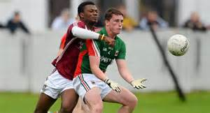
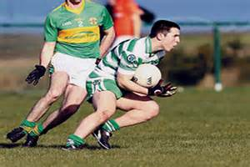
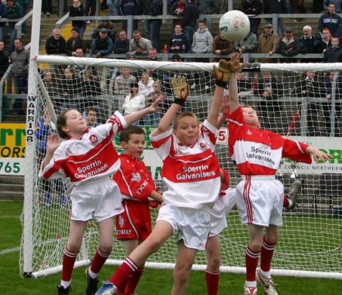
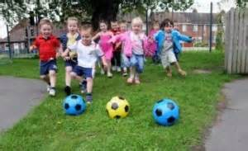
Up Skilling Player Pathway
Define Player Pathway

Slide 2
Nursery Hurling
TECHNICAL Handling – Correct Hurley size. Correct Grip. Open Ready Position - Hurl in writing hand. One Hand Catch – Bean Bag, Tennis ball, Sliotar. Rolling, Bowling, Throwing. Striking - 360 Swing – Static ball on ground Strike on the move. Ball Control – Stopping, Flick to space Bean Bag solo Bean Bag flick | GAME SENSE Zones used in games for early development of positional sense – Stops bunching Invasion Games - e.g. 2 v 1 Piggy In the Middle. Encourage players to play together. Target Games - Aim into or at a target to improve technique. E.g. Knock the tower Small sided games e.g. 2v2, 4v4 maximum
PHYSICAL Running – Marching, forward, backwards, side Jumping – 1 Leg/Both Legs/Variety of Directions Agility – Chasing Games, Evasion Games with Hurl in dominant hand Balance Exercises – Stand on 1 Leg, Rope Walks Coordination – Hand Eye – Cups & Saucers Bean Bag Solo One hand Dribble | LIFESTYLE Activity - 6 year olds must strive to partake in at least 60 minutes activity per day Social - Encourage players to share and interact in a group setting Respect - Insist on fair play Develop listening skills – Simon Says Game

Slide 3
8 Year Old Hurling
TECHNICAL Handling - Grip, Ready, Lock and Swing Catch – Claw Catch. Cupped Catch (Below Knee) Roll/Jab Lift (Stationary) Hand Pass bean bag/sliotar from hand. (1-2M) Striking - Ground Strike (8-10M) Left & Right Ball Control - Dribble/Flick to space Frontal Block Ground Intro to Shoulder Clash e.g. use Hurling rope | GAME SENSE Zones - Basic positional understanding Players play all positions to experience attack & defence (Go Games) Players look for space Support players on the ball Basic communication – call for the ball Small Sides games – 2v2,4v4, 6v6, 7v7 maximum
PHYSICAL Running - Speed developed through fun games – e.g. Here, There, Everywhere & Numbers Game Jumping – Jump for distance & in all directions Agility developed through fun games – e.g. Bulldog using tags Basic Resistance Exercises – Fun Squat preformed through “Laying an Egg” game | LIFESTYLE Activity - 8 year olds must strive to partake in at least 60 minutes activity per day Practice – Every child has their on ball at home. Play against a wall, with a friend, with group of friends. Imagine themselves as role models to improve skills. Social – Associate Gaelic Football with enjoyment and fun. Respect - Opponent & Referee

Slide 4
10 Year Old Hurling
Technical Striking Strike From the Hand (20-30M) Ground Strike (12-20M) Handling Hand Pass -left & right Overhead Catch - Hand protected Jab/Roll Lift – moving Ball Control Bean Bag/Ball Solo Stopping – High Ball/Batting Tackle Hook Frontal Block Shoulder Clash Use of Skills Testing | GAME SENSE Decision Making What to do? – Shoot/Pass/Travel with Ball(use 4 steps) Who to pass to/Who to mark Where to move to Scan the pitch – Play with head up Support - Support your team mates in attack/defence Small sided games 4v4, 6v6, 9v9Max
PHYSICAL Resistance Exercises - Own body weight strength (e.g. Bear Crawls) Partner Resistance Exercise (e.g. Tug of War) Continue to develop principles of Running & Jumping | LIFESTYLE Activity - 10 year olds must strive to partake in at least 60 minutes activity per day Practice - Incorporate regular football practice into everyday life. Practice at Home/Buddy System Coach needs to be aware of self-consciousness in learning new skills

Slide 5
12 Year Old Hurling
TECHNICAL Striking Strike from the hand (25-35M) Both sides Strike on the run Ground Strike (20-32M) L & R Handling Hand Pass – Both Hands & Off the hurl (3-5M) Catching – Low, Chest, High (Hand Protected) Jab lift at pace Ball Control Ground Flick Soloing Tackling Blocking Hooking Frontal Block & recover possession | GAME SENSE Space Ability to create space in possession Ability to deny space without possession Pressure Play conditioned games to create pressure. Adapt skills to control & maintain possession of the ball under pressure Small Sided Games - 4v4, 7v7, 10v10 Team learning to work in a team environment. Encourage & support team - mates
PHYSICAL Functional Strength/Stability - Opportunity to develop Core (e.g. Hips Pushes & Angry Cat) Speed Work - Develop multi-directional speed work. (e.g. 1 v 1 Behind knee slaps for footwork) Stamina – Endurance developed through fun relays , fun games, small sided games | LIFESTYLE 12 year olds must strive to partake in at least 60 minutes activity per day – Gaelic Games Make parents/players aware of the importance of Hydration & Nutrition Understand relation between effort & outcome Practice More specific individual practice - Skilled based Social Skills – interacting with team mates

Slide 6
14 Year Old Hurling
TECHNICAL Striking Strike from the hand (40M – 50M) left & Right Strike on the run Ground Strike (32-40M) L& R Apposed striking Striking over the Shoulder Handling Hand Pass – Both Hands & Off the Hurl (6-8M Moving) Catching – Low, Chest, High (Under pressure of an opponent) Batting/Doubling –High Ball Solo and Strike off Hurl Evasion – Solo changing direction (Match Situations) Tackling Blocking/Hooking (Under pressure of an opponent) Flick off the hurl | GAME SENSE Appreciate the space of a full size GAA pitch i.e. Use of width & depth. Attack Implement principles of attack – possession & support play Maintain possession. Moving the ball as a team. Defend Implement principles of defend – Delay, Deny, Dispossess, Deliver Decision Making Understand the specific responsibilities /decision making of the various position Small sided games 7v7 11v11 progressing to 15 aside
PHYSICAL Flexibility - through static stretching and dynamic mobility activities Speed– multidirectional, between 5M -25M with complete recovery in between. Built into warm up. Strength - Improve core strength through body weight exercise e.g. Plank | LIFESTYLE Make parents/players aware of the importance of Hydration & Nutrition Follow Players code of contact rules Develop own responsibility for match/training preparation Balance time between school & games

Slide 7
16 Year Old Hurling
TECHNICAL Striking Strike from the hand (25 – 30M) Shortened grip on the run Lift & Strike (On the run) Strike on front foot & back foot Sidelines Free Taking Feint & Strike Handling Hand Pass – Two hands and off the hurl (8-10M Moving) Tackling Blocking Hooking Flicking the ball away. (All done in Game Situations) | GAME SENSE Tactics Impose/Develop own game plan – e.g. Sweeper, Counter Attack, Direct Ball. Adapt to opposition game plan. Develop understanding of Set Plays e.g. Winning primary possession off set plays Player to Player Communication Attack Implement principles of attack – Width & Dept. Defence Implement principles of defend – Balance in team defending, depth & cover. Small Sided Games To develop skills under pressure
PHYSICAL Screening - Functional Movement Screening/Assessment to be carried out. Helps to highlight potential injuries and is followed up by Supervised Personal S&C program Strength - Maintain core body strength through suitable exercise e.g. Squat, Lunge, Push, Pull Endurance – Developed using the ball, ideally through small sided games (match situations). | LIFESTYLE Ability to mix with all team mates/coaches. Commitment to individual practice Personal responsibility to Hydration/Nutrition Manage rest and recovery e.g. Foam Rolling Develop mental toughness and calmness under pressure.

Slide 8
18 Year Old Hurling
TECHNICAL Strike from the hand (30-45M) Shortened Grip on the run Hand Pass – Three variations (10-12M moving) Tackling – Blocking/Hooking/Flicking the ball away Competing for the high ball/flick in the air (Games) Side Lines Free Taking | GAME SENSE Players comfortable in a variety of systems of play. Players are played in certain positions subject to their strengths. Intense small sides games (controlled aggression) to improve decision making
PHYSICAL Introduction to major lifting techniques & plyometric under supervision Implement a personal flexibility program – away from team environment | LIFESTYLE Ability to mix Commitment to Practice Punctuality Substance Awareness Manage rest and recovery

